Slide 1

Process Mining: Mastering Complexity Through Hierarchical Analysis
A comprehensive approach to managing complex event data in process mining through leveling, grouping, and variant analysis.

Slide 2
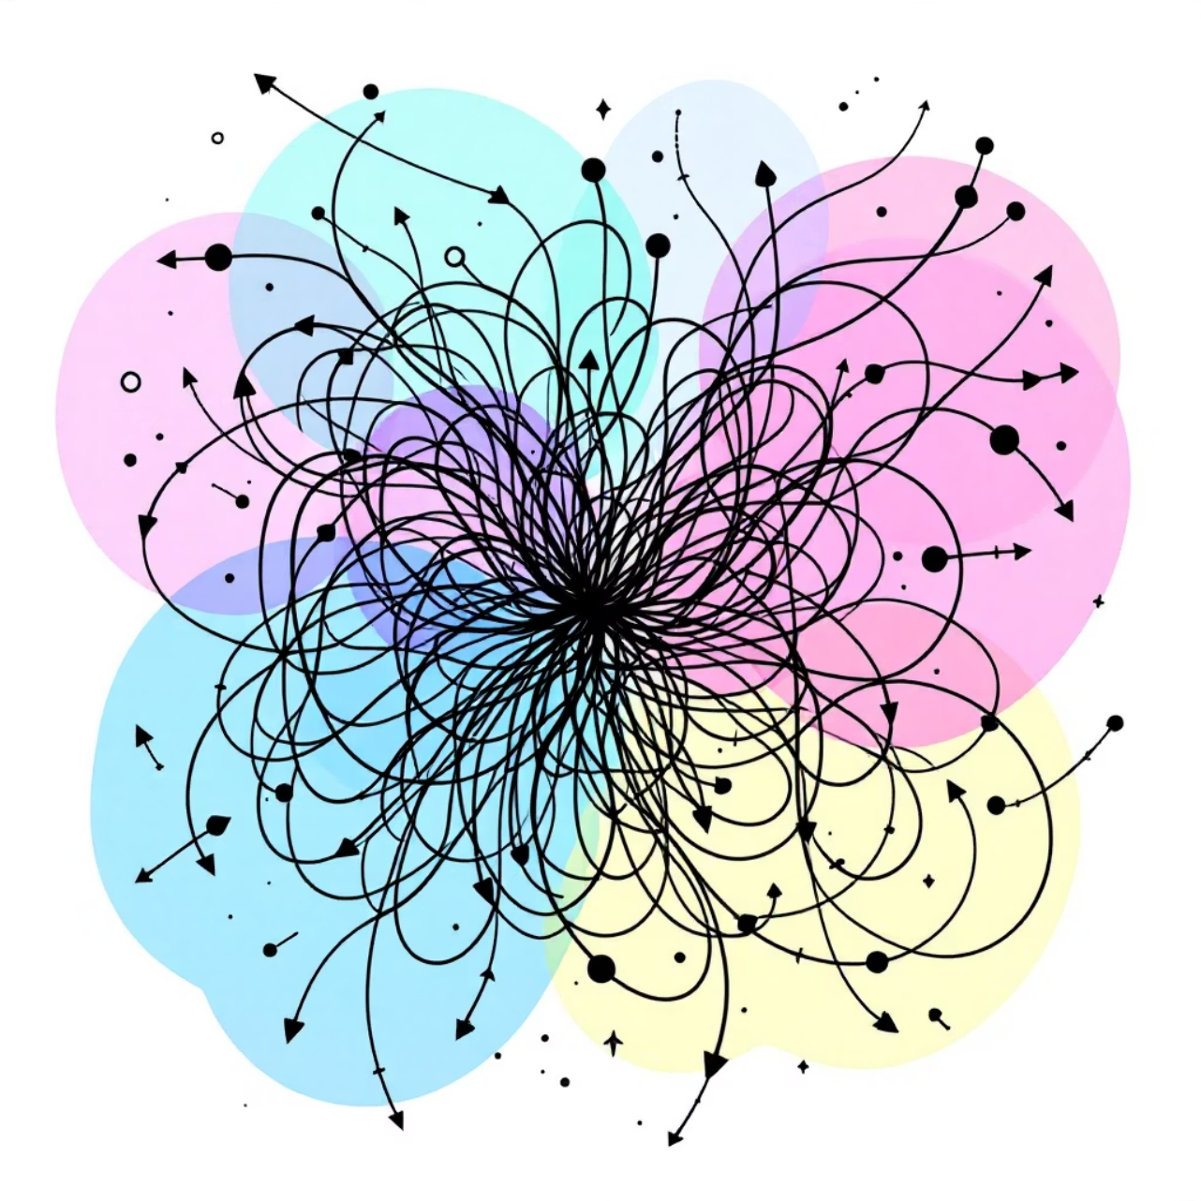
The Challenge of Process Complexity
Process mining extracts insights from event logs to visualize and improve business processes. However, real-world processes often generate massive event logs that create significant challenges:
Enterprise processes can contain thousands of unique events across departments and systems
A single customer journey might include hundreds of touchpoints
Without proper organization, process models become "spaghetti diagrams" - unreadable, unmanageable visualizations
Variant explosion occurs when minor differences create thousands of unique pathways through a process
Excessive detail obscures important patterns and makes comparative analysis nearly impossible
A "spaghetti diagram" resulting from unmanaged process complexity

Slide 3
The Power of Hierarchical Process Organization
Sub-Process
Process
Major functional segments within a process that accomplish specific business objectives
The highest level of abstraction representing an end-to-end business function (e.g., Order-to-Cash, Procure-to-Pay, Claim Processing)
Examples: Application Review, Credit Check, Account Creation
Example: Customer Onboarding Process
Events
Activities
Individual system or user actions captured in logs, representing the most granular level
Specific tasks or steps that comprise a sub-process, often performed by a single role
Examples: Field_Updated, Button_Clicked, Form_Submitted, API_Called
Examples: Validate Customer ID, Check Credit Score, Create Customer Profile
By organizing process data in this hierarchical structure, analysts can zoom in and out at appropriate levels of detail. This enables both high-level strategic analysis and detailed operational investigation without becoming overwhelmed by complexity.

Slide 4
The Problem of Variant Explosion
When analyzing process data at its most granular level, minor variations create an explosion of distinct process paths:
95%
10,000+
A process with just 20 possible events can theoretically have millions of unique pathways
Noise Ratio
Typical Variants
Even tiny differences (e.g., a single extra click or field update) create entirely new variants
Percentage of variants that represent less than 1% of total cases when using raw event data
Number of unique process paths in an enterprise-scale process without proper data leveling
In large enterprises, it's common to find 10,000+ variants in a single process
With too many variants, comparative analysis becomes impossible - you can't meaningfully compare thousands of paths
5-10
When 99% of cases follow unique paths, finding patterns and making improvements becomes extraordinarily difficult
Optimal Variants
Number of variants that can be effectively compared and analyzed at once

Slide 5




Leveling: From Generalization to Specialization
Level 1: Strategic View
Level 2: Operational View
Highest abstraction showing only major process stages (5-7 activities)
Medium abstraction showing sub-processes and their relationships (10-20 activities)
Useful for: Executive dashboards, KPI tracking, cross-process comparisons
Useful for: Process owners, operational management, performance monitoring
Level 3: Detailed View
Level 4: Technical View
Low abstraction showing specific activities and their sequence (20-50 activities)
Lowest abstraction showing system events and user interactions (50+ activities)
Useful for: Process analysts, improvement teams, automation opportunities
Useful for: IT teams, developers, system integration, technical troubleshooting
Leveling allows stakeholders to access the appropriate detail for their needs. Executives don't need to see every click, and developers may need to see technical events invisible to business users. A properly leveled process model serves all audiences effectively.

Slide 6


Activity Grouping Strategies
Functional Grouping
Temporal Grouping
Combine events based on business function or purpose, regardless of system or timing.
Combine events that typically occur within a specific timeframe.
Example: Group "Enter Customer Address," "Validate ZIP Code," and "Check Address Format" into a single "Address Verification" activity
Example: Group all actions taken within 5 minutes of case creation into "Initial Processing"
Role-Based Grouping
Outcome-Based Grouping
Combine events performed by the same role or department.
Combine events that contribute to the same business outcome.
Example: Group all underwriter actions into "Underwriting Review" regardless of specific steps
Example: Group all verification steps into "Customer Verification" regardless of method
System-Based Grouping
Combine events that occur within the same system or application.
Example: Group all CRM interactions into "CRM Processing" regardless of purpose
Best Practice: Maintain consistency in your grouping approach. Using multiple strategies simultaneously can create confusion and reduce the effectiveness of your process models.

Slide 7
Discovering and Managing Process Variants
What Are Process Variants?
Variant Discovery Techniques
Process variants are distinct paths cases can take through a process. They represent different ways to achieve the same outcome and often reveal:
Modern process mining tools use several techniques to identify meaningful variants:
Frequency-based clustering: Group similar paths based on how often they occur
Different customer segments with unique needs
Regional or departmental process differences
Edit distance algorithms: Measure similarity between case sequences
Evolving processes after system or policy changes
Exceptions and workarounds for special cases
Performance-based clustering: Group paths with similar duration or cost
Compliance violations or process breakdowns
Attribute-based segmentation: Group paths based on case attributes (customer type, product, region)
Machine learning classification: Use AI to identify patterns and group similar behaviors

Slide 8
Process Mining at Different Hierarchical Levels
1
2
3
End-to-End Process Mining
Sub-Process Mining
Activity-Level Mining
Analyze the complete business process from start to finish at a high level
Focus analysis on specific segments or functions within the larger process
Drill down to analyze specific activities or tasks within sub-processes
Identify major bottlenecks and inefficiencies between departments
Examine departmental or functional areas in depth
Identify detailed user behaviors and system interactions
Measure overall process KPIs (total duration, cost, quality)
Identify optimization opportunities within specific process stages
Uncover automation opportunities at the task level
Discover macro-level improvement opportunities
Compare performance across similar sub-processes
Detect compliance issues or procedural violations
Understand cross-functional handoffs and dependencies
Target improvements where they'll have the greatest impact
Support training and standardization initiatives
The key to successful process mining is applying the right level of analysis to match your specific improvement goals. Start broad to identify problem areas, then drill down for targeted solutions.

Slide 9
Case Study: Insurance Claims Processing
Initial Challenge
Hierarchical Approach
A major insurance provider struggled with inefficient claims processing:
The team implemented a three-level process hierarchy:
Average claim took 27 days to process
Level 1: 6 major stages (Intake, Verification, Assessment, Decision, Payment, Closure)
Event logs contained over 500 unique activities
Process mining revealed 12,000+ unique variants
Level 2: 24 sub-processes across the 6 stages
"Spaghetti diagram" process model was uninterpretable
Level 3: 120 key activities within the sub-processes
Unable to identify improvement opportunities in the chaos
Results at Level 1
Results at Level 2
Discovered 85% of delays occurred in the Assessment stage, prioritizing it for deeper analysis
Identified "Medical Review" sub-process as the critical bottleneck, with 3 main variants
Results at Level 3
Final Outcome
Pinpointed specific activities causing delays: missing documentation, inconsistent coding, and manual approval loops
Targeted improvements reduced claim processing time by 62% and saved $4.2M annually

Slide 10
Key Takeaways: Mastering Process Complexity
1
Embrace Hierarchical Process Organization
Structure your processes into clear levels: processes, sub-processes, activities, and events. This creates clarity and enables appropriate analysis at each level.
2
Implement Consistent Activity Grouping
Group low-level events into meaningful business activities using a consistent methodology based on function, role, system, time, or outcome.
3
Apply Level-Appropriate Analysis
Match your analysis depth to your improvement goals. Start broad to identify problem areas, then drill down for targeted solutions.
4
Focus on Meaningful Variants
Reduce variant complexity by

